Slide 1
Object Oriented Programming
Swing
Lecture 16

Slide 2
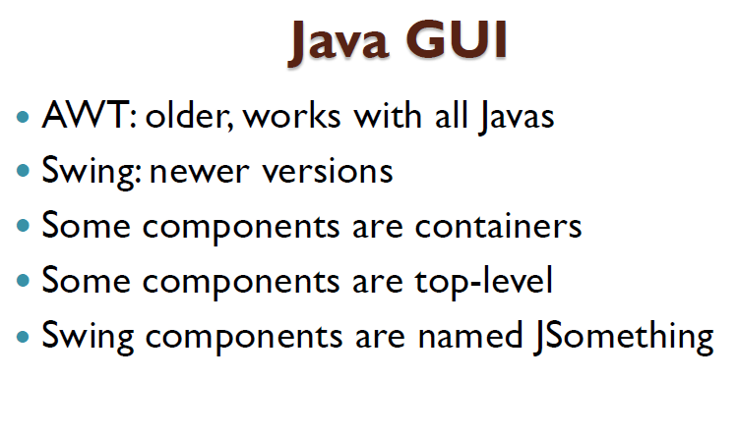

Slide 3
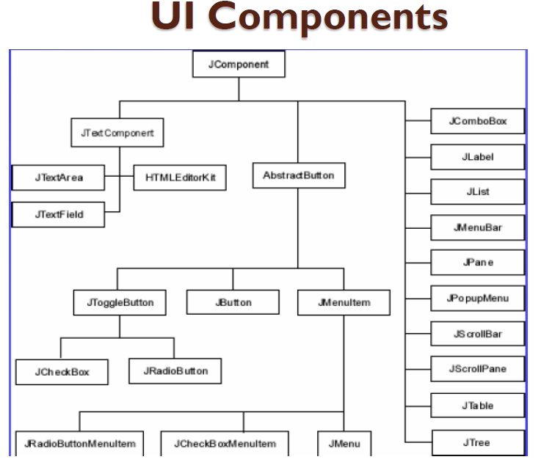

Slide 4
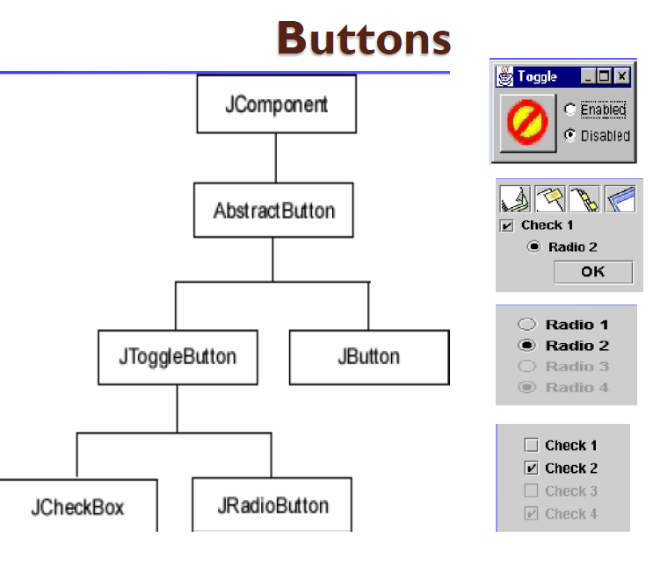

Slide 5
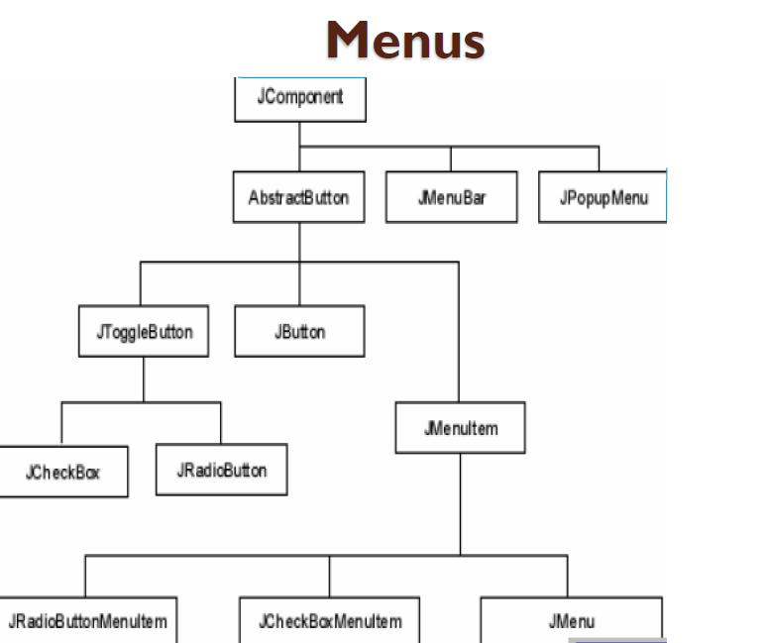

Slide 6
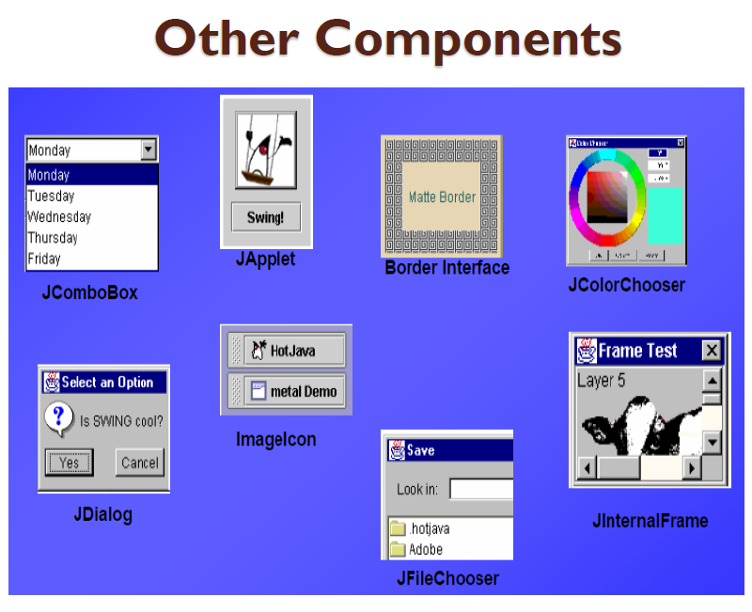

Slide 7
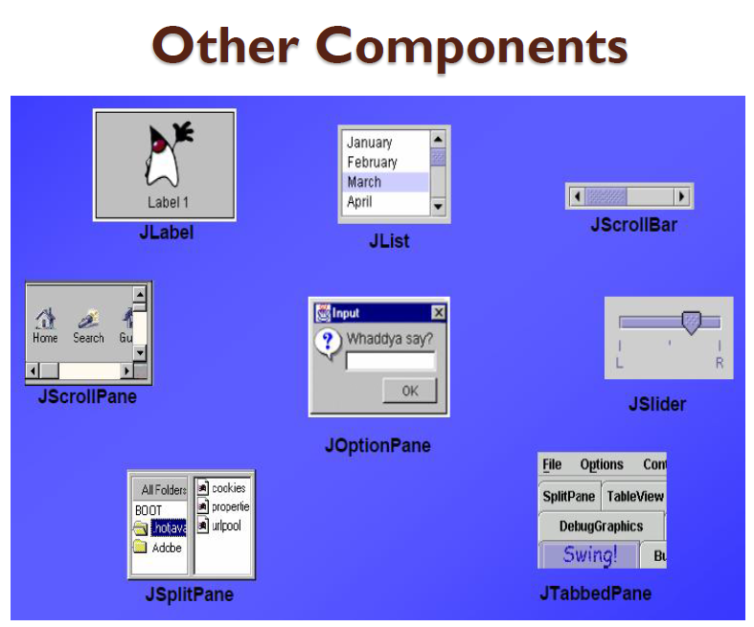

Slide 8
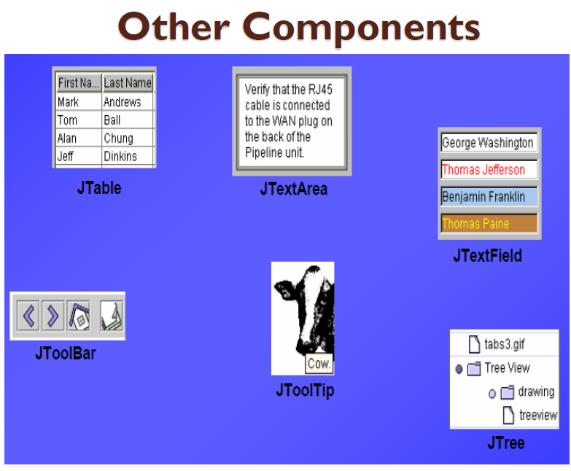

Slide 9
Layout Manager Heuristics
null
FlowLayout
GridLayout
none, programmer sets x,y,w,h
Left to right,
Top to bottom
BorderLayout
CardLayout
GridBagLayout
n
One at a time
c
w
e
JButton
s

Slide 10
import javax.swing.JFrame; import javax.swing.JLabel; public class HelloWorldSwing { public static void main(String[] args) { JFrame frame = new JFrame("HelloWorldSwing"); final JLabel label = new JLabel("Hello World"); frame.getContentPane().add(label); frame.setDefaultCloseOperation(JFrame.EXIT_ON_CLOSE); frame.pack(); frame.setVisible(true); } }

Slide 11


Slide 12
import javax.swing.*;
import java.awt.*;
public class FlowLayout2 {
public static void main(String[] args) {
JFrame f = new JFrame("FlowLayout demo");
f.setLayout(new FlowLayout());
f.add(new JButton("Red"));
f.add(new JButton("Blue"));
f.add(new JButton("White"));
JList list = new JList();
f.add(list);
f.add(new JCheckBox("Pick me", true));
f.add(new JLabel("Enter name here:"));
f.add(new JTextField(20));
f.pack();
f.setVisible(true);
}
}

Slide 13
import java.awt.BorderLayout;
import java.awt.Dimension;
import java.awt.FlowLayout;
import javax.swing.JButton;
import javax.swing.JFrame;
import javax.swing.JPanel;
public class FlowLayout3 extends JPanel {
public FlowLayout3() {
// Use a FlowLayout layout manager. Left justify rows.
// Leave 10 pixels of horizontal and vertical space between components.
this.setLayout(new FlowLayout(FlowLayout.LEFT, 10, 10));
// Add some buttons to demonstrate the layout.
String spaces = ""; // Used to make the buttons different

Slide 14
for (int i = 1; i <= 9; i++) {
this.add(new JButton("Button #" + i + spaces));
spaces += " ";
}
}
public static void main(String[] args) {
JFrame frame = new JFrame();
frame.getContentPane().add(new FlowLayout3(), BorderLayout.CENTER);
// Finally, set the size of the main window, and pop it up.
frame.setSize(600, 400);
frame.setVisible(true);
}
}

Slide 15
public class BorderLayoutDemo extends JFrame {
private JButton north, south, east, west, center;
public BorderLayoutDemo(String title) {
super(title);
north = new JButton("North");
south = new JButton("South");
east = new JButton("East");
west = new JButton("West");
center = new JButton("Center");
this.add(north, BorderLayout.NORTH);
this.add(south, BorderLayout.SOUTH);
this.add(east, BorderLayout.EAST);
this.add(west, BorderLayout.WEST);
this.add(center, BorderLayout.CENTER);
}
public static void main(String[] args) {
JFrame f = new BorderLayoutDemo("BorderLayout demo");
f.pack();
f.setVisible(true);
}
}

